Slide 1

Chapter 11 :: Logic Languages
Programming Language Pragmatics
Michael L. Scott
Copyright © 2009 Elsevier

Slide 2
Logic Programming
Based on predicate calculus
Predicates - building-blocks P(a₁,a₂,...,a_{K})
  limit(f, infinity, 0)
  enrolled(you, CS344)
  These are interesting because we attach meaning to them, but within the logical system they are simply structural building blocks, with no meaning beyond that provided by explicitly-stated interrelationships
Copyright © 2009 Elsevier

Slide 3
Logic Programming Concepts
Operators
  conjunction, disjunction, negation, implication
Universal and existential quantifiers
Statements
  sometimes true, sometimes false, often unknown
  axioms - assumed true
  theorems - provably true
  hypotheses (goals) - things we'd like to prove true
Copyright © 2009 Elsevier

Slide 4
Logic Programming Concepts
Familiar example statements (right?):
all f, l [
limit(f, x0, l) <=>
(all e [
e > 0 => (exists d [
d > 0 and all x [
((|x-x0| < d) => (|f(x)-l|) < e)]])])]
all f, g [f = O(g) <=
(exist c, n0 [
all n [
n > n0 => f(n) < cg(n)]])]
Copyright © 2009 Elsevier

Slide 5
Logic Programming Concepts
Most statements can be written many ways
That's great for people but a nuisance for computers
  It turns out that if you make certain restrictions on the format of statements you can prove theorems mechanically
  That's what logic programming systems do
  Unfortunately, the restrictions that we will put on our statements will not allow us to handle most of the theorems you learned in math, but we will
  have a surprising amount of power left anyway
Copyright © 2009 Elsevier

Slide 6
Logic Programming Concepts
We insist that all statements be in the form of HORN CLAUSES consisting of
a head and a body
  The head is a single term
  The body is a list of terms
  A term can be a constant, eg “rochester is rainy”, a variable, eg X, or a structure
  Example: H <- B1, B2, …, BN means if B1 and B2 and…B2 are true, then H is true
Copyright © 2009 Elsevier

Slide 7
Logic Programming Concepts
Structures consists of a functor plus a list of arguments.
Functors look like function calls, but they are not! (They also aren’t the same as functors in Haskell.)
These are all true/false statements, asserting some fact.
Example:
  rainy(rochester)
  teaches(chambers, cs344)
  rainy(X)
Copyright © 2009 Elsevier

Slide 8
Prolog: an example language
A structure can play the role of a data structure or a predicate
  A constant is either an ATOM or a NUMBER
  An atom is either what looks like an identifier beginning with a lower-case letter, or a quoted character string
  A number looks like an integer or real from some more ordinary language
  A variable looks like an identifier beginning with an upper-case letter
Copyright © 2009 Elsevier

Slide 9
Prolog
Examples:
  Atom: foo, my_const, +, ‘Hello’
  Numbers: 2, 5.1, etc
  Variable: Foo, X, My_var
There are no declarations
All types are discovered implicitly
Copyright © 2009 Elsevier

Slide 10
Logic Programming Concepts
The meaning of the statement is that the conjunction of the terms in the body implies the head
  A clause with an empty body is called a FACT
  A clause with an empty head is a QUERY, or top-level GOAL
  A clause with both sides is a RULE
The Prolog interpreter has a collection of facts and rules in its DATABASE
  Facts are axioms - things the interpreter assumes to be true
Copyright © 2009 Elsevier

Slide 11
Prolog
Facts:
  rainy(rochester).
  cold(rochester).
  rainy(seattle)
Rules:
  snowy(X) :- rainy(X), cold(X).
  The :- is implication, and , is an and.
Query:
  ?- snowy(A)
Given these facts and rules along with this query, Prolog would return A = rochester
Copyright © 2009 Elsevier

Slide 12
Prolog
Given this:
  rainy(rochester).
  cold(rochester).
  rainy(seattle)
  snowy(X) :- rainy(X), cold(X).
Query: ?- rainy(B)
Prolog will return B = rochester (since it goes in order in the database).
Type semicolon to ask prolog to continue:
  B = rochester ;
  B = seattle ;
  No
Copyright © 2009 Elsevier

Slide 13
Prolog
Prolog can be thought of declaratively or imperatively:
  We’ll emphasize the declarative semantics for now, because that's what makes logic programming interesting
  We'll get into the imperative semantics later
Prolog allows you to state a bunch of axioms
  Then you pose a query (goal) and the system tries to find a series of inference steps (and assignments of values to variables) that allow it to prove your
  query starting from the axioms
Copyright © 2009 Elsevier

Slide 14
Prolog
The meaning of the statement is that
mother(mary, fred).
% you can either think of this as
% a predicate asserting that mary
% is the mother of fred -
% or a data structure (tree)
% in which the functor (atom)
% mother is the root,
% mary is the left child, and
% fred is the right child
fat(albert).
rainy(rochester).
Copyright © 2009 Elsevier

Slide 15
Prolog
Rules are theorems that allow the interpreter to infer things
To be interesting, rules generally contain variables
employed(X) :- employs(Y,X).
can be read:
for all X, X is employed if there
exists a Y such that Y employs X
Note the direction of the implication:
  The example does NOT say that X is employed ONLY IF there is a Y that employs X
Copyright © 2009 Elsevier

Slide 16
Prolog
The scope of a variable is the clause in which it appears
  Variables whose first appearance is on the left hand side of the clause have implicit
  universal quantifiers
  Variables whose first appearance is in the body of the clause have implicit existential quantifiers
Similarly:
Copyright © 2009 Elsevier

Slide 17
Prolog
grandmother(A, C) :- mother(A, B), mother(B, C).
can be read:
for all A, C [A is the grandmother of C if there exists a B such that A is the mother of B and B is the mother of C].
We probably want another rule that says
grandmother(A, C) :- mother(A, B), father(B, C).
Copyright © 2009 Elsevier

Slide 18
Prolog
To run a Prolog program, one asks the interpreter a question
  This is done by stating a theorem - asserting a predicate - which the interpreter tries to prove
    If it can, it says yes
    If it can't, it says no
    If your predicate contained variables, the interpreter prints the values it had to give them to make the predicate true.
Copyright © 2009 Elsevier

Slide 19
Prolog
The interpreter works by what is called BACKWARD CHAINING
  It begins with the thing it is trying to prove and works backwards looking for things that
  would imply it, until it gets to facts
It is also possible in theory to work forward from the facts trying to see if any of the things you can prove from them are what you were looking for - that can be very time-consuming
  Fancier logic languages use both kinds of chaining, with special smarts or hints from the user to bound the searches
Copyright © 2009 Elsevier

Slide 20
Prolog
The predicate you ask for is the interpreter's original GOAL
  In an attempt to SATISFY that goal, it looks for facts or rules with which the goal can be UNIFIED
    Unification is a process by which compatible
    statements are merged
  Any variables that do not yet have values but
  which correspond to constants or to variables with values in the other clause get INSTANTIATED with that value
  Anyplace where uninstantiated variables correspond, those variables are identified with each other, but remain without values
Copyright © 2009 Elsevier

Slide 21
Prolog
The interpreter starts at the beginning of your database (this ordering is part of Prolog, NOT of logic programming in general) and looks for something with which to unify the current goal
  If it finds a fact, great; it succeeds
  If it finds a rule, it attempts to satisfy the terms in the body of the rule depth first
  This process is motivated by the RESOLUTION PRINCIPLE, due to Robinson:
    It says that if C1 and C2 are Horn clauses, where C2 represents a true statement and the head of C2 unifies with one of the terms in the body of C1, then we can replace the term in C1 with the body of C2 to obtain another statement that is true if and only if C1 is true
Copyright © 2009 Elsevier

Slide 22
Prolog: Resolution and Unification
Example:
takes(jane, cs344).
  takes(jane, math266).
  takes(alice, phil205).
  takes(alice, cs344).
  classmates(X,Y) :- takes(X,Z), takes(Y,Z).
Now, let X be jane and Z be cs344, we can replace the first term on righthand side of the last clause (C1) with the (empty) body of the first clause above (C2), giving:
  classmates(jane, Y) :- takes(Y, cs344).
This is essentially pattern matching. Associating X with jane and Z with cs344 is called unification, and the variables are said to be instantiated.
Copyright © 2009 Elsevier

Slide 23
Prolog: Equality
Equality is defined in terms of unifiability.
Example: =(A,B)succeeds if and only if A and B can be unified
Example:
?- a = a.
Yes
?- a = b.
No
?- foo(a,b) = foo(a,b).
Yes
?- X=a.
X = a;
No
Copyright © 2009 Elsevier

Slide 24
Prolog: Equality
Equality with variables is a bit different; this unifies the variables without actually instantiating them.
Example:
?- A = B
A = B
?- A = B, A = x, B = Y.
A = x
B = x
Y = x
Copyright © 2009 Elsevier

Slide 25
Prolog: Lists
Lists are useful enough that prolog has built in support.
Structure: [] is the empty list, and . is a built in concatenation (like : in Haskell). So a list is:
.(a, .(b, .(c, [])))
Can also be written:
[a, b, c]
[a | [b,c]]
[a, b | [c]]
[a, b, c | []]
Copyright © 2009 Elsevier

Slide 26
Prolog: Lists
List predicates:
member(X, [X | _]).
member(X, [_ | T]) :- member(x,T).
sorted([]).
sorted([_]).
sorted([A, B | T]) :- A =< B,
sorted([B | T]).
Copyright © 2009 Elsevier

Slide 27
Prolog: Lists
Even crazier:
append([], A, A).
append([H | T], A, [H | L]) :-
append(T, A, L).
Now using it:
?- append([a, b, c], [d, e], L).
L = [a, b, c, d, e]
?- append(X, [d, e], [a, b, c, d, e]).
X = [a, b, c]
?- append([a, b, c], Y, [a, b, c, d, e]).
Y = [d, e]
Copyright © 2009 Elsevier

Slide 28
Prolog
Arithmetic: The '=' operator determines whether its operands can be unified
?- A = 37.
A = 37
yes
?- 2 = 2.
yes
Math operators are functors (structure names), not functions
?- (2+3) = 5
no
Copyright © 2009 Elsevier

Slide 29
Prolog
For math we use the built-in operator is
?- is(X, 1+2).
X = 3
yes
?- X is 1+2.
X = 3
yes
% LHS of 'is' must be as-yet uninstantiated
?- 1+2 is 4-1.
no
% RHS of 'is' must already be instantiated
?- X is Y.
<error>
Copyright © 2009 Elsevier

Slide 30
Prolog
When it attempts resolution, the Prolog interpreter pushes the current goal onto a stack, makes the first term in the body the current goal, and goes back to the beginning of the database and starts looking again
If it gets through the first goal of a body successfully, the interpreter continues
with the next one
If it gets all the way through the body, the goal is satisfied and it backs up a level and proceeds
Copyright © 2009 Elsevier

Slide 31
Prolog
If it fails to satisfy the terms in the body of a rule, the interpreter undoes the unification of the left hand side (this includes uninstantiating any variables that were given values as a result of the unification) and keeps looking through the database for something else with which to unify (This process is called BACKTRACKING)
If the interpreter gets to the end of database without succeeding, it backs out a level (that's how it might fail to satisfy something in a body) and continues from there
Copyright © 2009 Elsevier

Slide 32
Prolog
We can visualize backtracking search as a tree in which the top-level goal is the root and the leaves are facts (see Figure 11.2 - next slide)
  The children of the root are all the rules and facts with which the goal can unify
  The interpreter does an OR across them: one of them must succeed in order for goal to succeed
  The children of a node in the second level of the tree are the terms in the body of the rule
  The interpreter does an AND across these: all of them must succeed in order for parent to succeed
  The overall search tree then consists of alternating AND and OR levels
Copyright © 2009 Elsevier

Slide 33
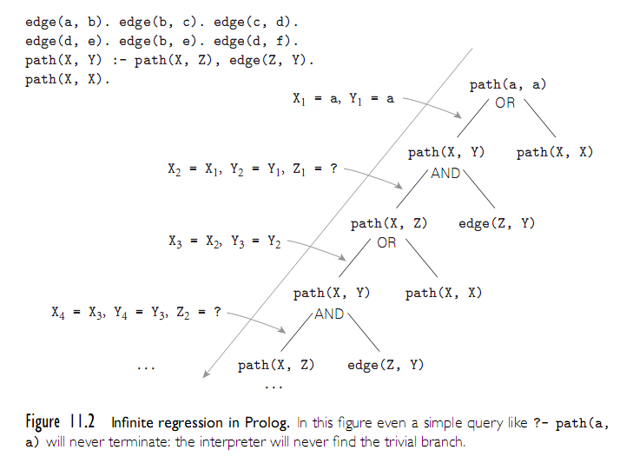
Prolog
Copyright © 2009 Elsevier

Slide 34
Prolog: Example
Be careful of ordering:
edge(a, b). edge(b,c). edge(c,d).
edge(d, e). edge(b, e). edge(d, f).
path(X, X).
path(X, Y):- edge(Z, Y), path(X, Z).
If the two terms on the last clause were reversed, the program would be less efficient. Why?
If we were to flip order of the last 2 clauses, things get even worse!
Copyright © 2009 Elsevier

Slide 35
Prolog
PROLOG IS NOT PURELY DECLARATIVE
  The ordering of the database and the left-to-right pursuit of sub-goals gives a deterministic imperative semantics to searching and backtracking
  Changing the order of statements in the database can give you different results
    It can lead to infinite loops
    It can certainly result in inefficiency
Copyright © 2009 Elsevier

Slide 36
Prolog
parent(a,b). % a is the parent of b
parent(a,d).
parent(a,k).
parent(k,l).
parent(k,m).
parent(b,e).
parent(b,f).
parent(f,g).
parent(f,h).
parent(f,i).
ancestor(X,Y) :- parent(X,Y).
ancestor(X,Y) :- parent(Z,Y), ancestor(X,Z).
Copyright © 2009 Elsevier

Slide 37
Prolog
Then the question
?- ancestor(U,h).
generates the answers
U = f;
U = b;
U = a;
no
The question
?- ancestor(b,U).
generates all nodes in the subtree rooted in b << trace >>
Copyright © 2009 Elsevier

Slide 38
Prolog
If we change the order of the two ancestor rules, we get different execution orders:
?- ancestor(U,h).
U = a;
U = b;
U = f;
no
If we change the order of the subgoals in the compound rule,
ancestor(X,Y) :- ancestor(X,Z), parent(Z,Y).
we run into an infinite loop (see also Figure 11.2)
Copyright © 2009 Elsevier

Slide 39
Imperative Control Flow
Some options in Prolog actually alter the flow of control. Recall this example::
member(X, [X | _]).
member(X, [_ | T]) := member(X,T).
If a given atom a is in the list n times, the the goal ?- member(a,L)can succeed n times.
This can be very inefficient in some cases, since we may have some other goal to satisfy that could fail:
  prime_candidate(X) := member(X, candidates),
  prime(X).
  (Here, if a is in the list of candidates more than once, we’ll waste time checking for it that number of times, when we already “know” that prime(a) will just fail.)
Copyright © 2009 Elsevier

Slide 40
Control flow - the cut
We can save time by cutting off all future searches for a after the first time it is found:
member(X, [X | _]) :- !.
member(X, [_ | T]) := member(X,T).
The cut is the ! on the right hand side. This says that if X is the head of L, we should not attempt to unify member(X,L)with the left-hand side of the second rule. Essentially, the cut forces us to commit to the first rule only.
Copyright © 2009 Elsevier

Slide 41
Control flow - \=
Another option is to force the first element of the list to not be equal to X in the second rule:
member(X, [X | _]) :- !.
member(X, [H | T]) := X \= H, member(X,T).
The statement X \= H is equivalent to the statement \+(X = H). In essence, \+ is a bit like a not (which is how it is written in some versions of Prolog), but this can be a bit misleading.
Copyright © 2009 Elsevier

Slide 42
Control flow - back to the cut
One really interesting use of ! is as an equivalent to if-then-else statements:
statement := condition, !, then_part.
statement := else_part.
Here, the cut commits us to the first part if condition is true, which means we will never go to the second rule.
However, if the condition comes back as false (i.e. no derivation is found to make it true), then we’ll move onto the second rule and try to find if it can be satisfied.
Copyright © 2009 Elsevier

Slide 43
Control flow - the fail predicate
The fail predicate always fails.
It can be quite useful to force certain actions. For example, the \+ can be implemented using fail and !: =\+(X=H) :- (X=H), !, fail.
It can also be used to generate a type of “looping” behavior. As an example, recall our append code:
append([], A, A).
append([H | T], A, [H | L]) :-
append(T, A, L).
If we write append(A,B,L) where L is instantiated by A and B are not, we can use this to generate possible lists.
Copyright © 2009 Elsevier

Slide 44
Control flow - the fail predicate
If we write append(A,B,L) where L is instantiated by A and B are not, we can use this to generate possible lists:
print_lists(L) :-
and(A,B,L), write(A),
write(‘ ‘), write(B),
nl, fail.
The output if we call print_lists([a, b, c]) will be:
  [] [a, b, c]
  [a] [b, c]
  [a, b] [c]
  [a, b, c] []
  No
Copyright © 2009 Elsevier

Slide 45
Looping and unbounded generators
The following generates all of the natural numbers:
natural(1).
natural(N) :- natural(M), N is M+1.
We can then use this to print out the first n numbers:
  my_loop(N) := natural(I),
  write(I), nl,
  I = N, !.
  So long as I is less than N, the equality predicate will fail and backtracking will pursue another alternative for natural. If I is equal to N, then the cut will execute, committing us to the final value of I and terminating this loop.
Copyright © 2009 Elsevier

Slide 46
Looping and unbounded generators
This programming idiom - an unbounded generator with a test-cut terminator - is know as generate-and-test.
This combination is generally used with side effects, such as I/O or modification of the database.
For example, we could use such a construct to add values to the database until some threshold is met.
Copyright © 2009 Elsevier

Slide 47
I/O in prolog
Prolog provides several I/O predicates, such as:
  write and nl for output, read for input
  see and tell can redirect input and output to different files.
  get and put read individual characters.
  consult and reconsult add database clauses from a file, so that they don’t have to be entered by hand.
Copyright © 2009 Elsevier

Slide 48
Database Manipulation
Prolog is homoiconic: it can represent itself (like Scheme).
It can also modify itself:
  ?- rainy(X)
  X = seattle ;
  X = rochester ;
  No
  ?- assert(rainy(syracuse)).
  Yes
  ?- retract(rainy(rochester)).
  Yes
  ?- rainy(X)
  X = seattle ;
  X = syracuse ;
  No
Copyright © 2009 Elsevier

Slide 49
Additional predicates
The goal functor(T, F, N) succeeds if and only if T is a term with functor F and arity N:
  ?- functor(foo(a,b,c), foo, 3).
  Yes
  ?- functor(foo(a,b,c), F, N).
  F = foo
  N = 3
  ?- functor(T, foo, 3).
  T = foo(_10, _37, _24)
The goal arg(N, T, A) succeeds if and only if its first two arguments are instantiated, N is a number, and A is the Nth argument of T:
  ?- arg(3, foo(a,b,c), A).
  A = c
Copyright © 2009 Elsevier

Slide 50
Using arg and functor
We can use these together to create an arbitrary term:
  ?- functor(T, foo, 3), arg(1, T, a), arg(2, T, b), arg(3, T, c)
  T = foo(a, b, c)
We can also use =.. for this:
  ?- T =.. [foo, a, b, c]
  T = foo(a,b,c)
  ?- foo(a,b,c) =.. [F, A1, A2, A3]
  F = foo
  A1 = a
  A2 = b
  A3 = c
Copyright © 2009 Elsevier

Slide 51
Dynamic goals
Taken together, we can attempt to satisfy goals that are created at run-time only:
  param_loop(L, H, F) :- natural(I), I >= L,
  G =.. [F, I], call(G), I=H, !.
Then calling:
  ?- param_loop(5, 10, write).
  5678910
  Yes
Copyright © 2009 Elsevier

Slide 52
A final example
It is worth reiterating that prolog is NOT really a traditional language which executes statements in a von Neumann-like way.
Prolog does provde some mechanisms for this, but they can be very ineffienct (especially if you’re not used to the language).
  sort(L1, L2) := permutation(L1, L2), sorted(L2).
  permutation([], []).
  permutation(L, [H | T]) :-
  append(P, [H | S], L),
  append(P, S, W),
  permutation(W,T).
If this looks confusing, don’t worry. We’re essentially saying L2 is a sorted version of L1 if it’s a permutation of L1 and it is sorted.
This version takes exponential time. Why?
Copyright © 2009 Elsevier

Slide 53
A final example: quicksort
Implementing something like quick sort is possible:
  quicksort([], []).
  quicksort([A, L1], L2) :- partition(A, L1, P1, S1),
  quicksort(P1, P2), quicksort(S1, S2),
  append(P2, [A | S2], L2).
  partition(A, [], [], []).
  partition(A, [H | T], [H | P], S) :- A >= H, partition(A, T, P, S).
  partition(A, [H | T], [P], [H | S]) :- A =< H, partition(A, T, P, S).
Copyright © 2009 Elsevier

Slide 54
Conclusions
Like other forms of programming, logic languages are linked to constructive proofs.
But imperative and functional languages are in some sense a proof in and of themselves, since they compute something.
In contract, a logic language is a set of axioms from which the computer itself tried to construct the proof.
Logic langauges also don’t have the full power of computation (Turing machines or lambda calculus). They are based on propositional logic, and even there lack the full power due to practical considerations.
Generally, these are used in problems where relationships and searching are emphasized.
Copyright © 2009 Elsevier

Slide 55
Prolog
Tic-tac-toe (see Figure 11.3 on next slide)
  This program finds the next move, given
  a board configuration
  It does not play a whole game (see the book for an extended version that does)
  It depends on the ordering of rules
    move(A) is the root rule
    A is a result parameter
  No winning strategy
    each player can force a draw
Copyright © 2009 Elsevier

Slide 56
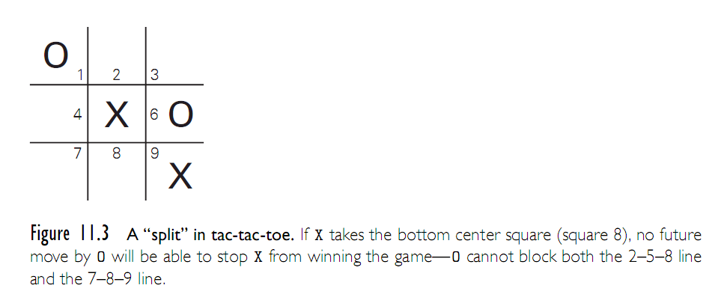
Prolog
Copyright © 2009 Elsevier

Slide 57
Logic Programming Examples
% express that three given squares lie in a line
ordered_line(1,2,3). ordered_line(4,5,6).
ordered_line(7,8,9). ordered_line(1,4,7).
ordered_line(2,5,8). ordered_line(3,6,9).
ordered_line(1,5,9). ordered_line(3,5,7).
line(A,B,C) :- ordered_line(A,B,C).
line(A,B,C) :- ordered_line(A,C,B).
line(A,B,C) :- ordered_line(B,A,C).
line(A,B,C) :- ordered_line(B,C,A).
line(A,B,C) :- ordered_line(C,A,B).
line(A,B,C) :- ordered_line(C,B,A)
% we assume a not so perfect opponent
Copyright © 2009 Elsevier

Slide 58
Prolog
% the following rules work well
move(A) :- good(A), empty(A).
full(A) :- x(A).
full(A) :- o(A).
empty(A):- not full(A)
% strategy (key is ordering following five rules)
good(A) :- win(A).
good(A) :- block_win(A).
good(A) :- split(A).
good(A) :- block_split(A).
good(A) :- build(A).
Copyright © 2009 Elsevier

Slide 59
Prolog
% first choice is to win(1)
win(A) :- x(B), x(C), line(A,B,C).
% block opponent from winning (2)
block_win(A) :- o(B), o(C), line(A,B,C).
% opponent cannot block us from winning next
% see Figure 11.6 before for this case(3)
split(A) :- x(B), x(C), different(B,C),
line(A,B,D), line(A,C,E),
empty(D), empty(E).
same(A,A).
different(A,B) :- not same(A,B).
Copyright © 2009 Elsevier

Slide 60
Prolog
% prevent opponent from creating a split (4)
block_split(A) :- o(B), o(C), different(B,C),
line(A,B,D), line(A,C,E),
empty(D), empty(E).
% pick a square toward three in a row (5)
build(A) :- x(B), line(A,B,C), empty(C).
% if none of the five, final defaults (in this order)
good(5).
good(1). good(3). good(7). good(9).
good(2). good(4). good(6). good(8).
Copyright © 2009 Elsevier

